Slide 1

Normalization Process: First, Second & Third Normal Form and BCNF .

Slide 2
Lossless-join and Dependency Preservation Properties
  Lossless-join property enables us to find any instance of the original relation from corresponding instances in the smaller relations.
  Dependency preservation property enables us to enforce a constraint on the original relation by enforcing some constraint on each of the smaller relations.

Slide 3

Loss-less and lossy join decomposition
B | C
2 | 1
2 | 2
3 | 2
A | B | C
1 | 2 | 1
2 | 2 | 2
3 | 3 | 2
R
R1
A | B
1 | 2
2 | 2
3 | 3

Slide 4
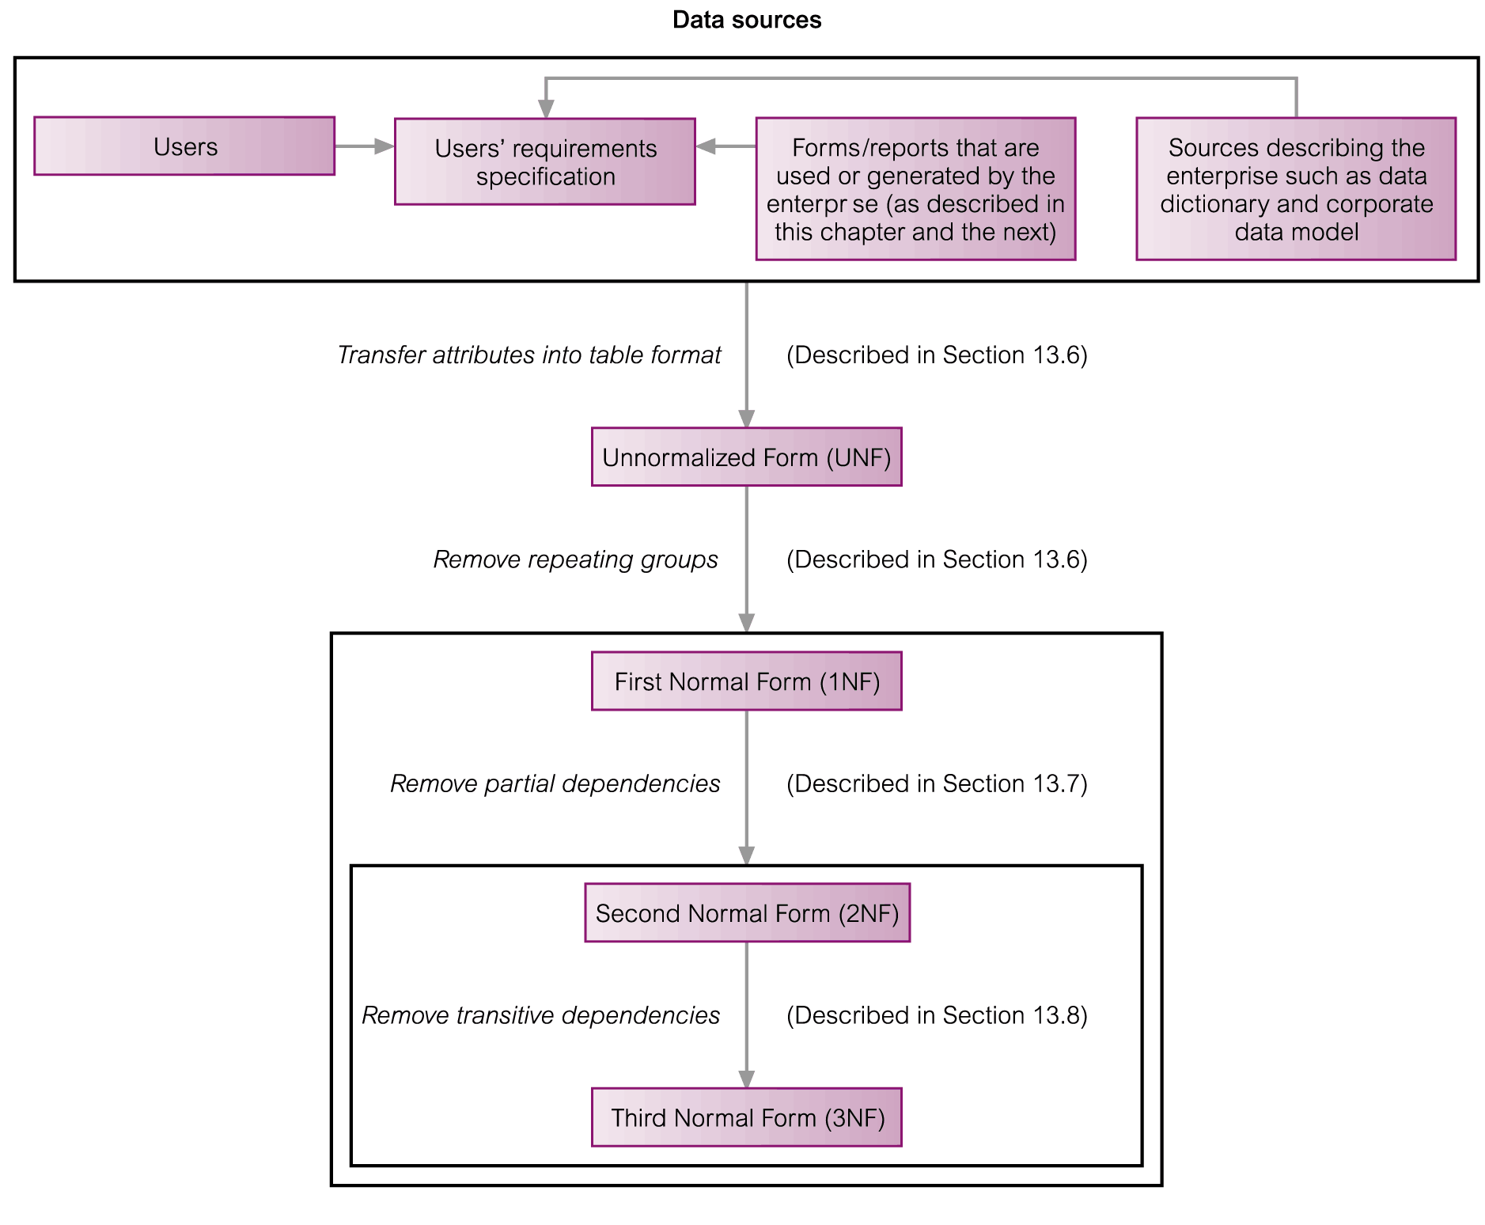
The Process of Normalization

Slide 5
Unnormalized Form (UNF)
A table that contains one or more repeating groups.
To create an unnormalized table
  Transform the data from the information source (e.g. form) into table format with columns and rows.

Slide 6
1NF
According to EF Codd ,The table should not be containing any multivalued attribute.
Nominate an attribute or group of attributes to act as the key for the unnormalized table.
Identify the repeating group(s) in the unnormalized table which repeats for the key attribute(s).

Slide 7
2NF
Based on the concept of full functional dependency.
Full functional dependency indicates that if
  A and B are attributes of a relation,
  B is fully dependent on A if B is functionally dependent on A but not on any proper subset of A.

Slide 8
2NF
Table must be in 1NF .
All the non- Primary key attributes should be fully functional dependent on candidate key
In other words, there should be no partial dependency in the table

Slide 9
1NF to 2NF
Identify the primary key for the 1NF relation.
Identify the functional dependencies in the relation.
If partial dependencies exist on the primary key remove them by placing, then in a new relation along with a copy of their determinant.

Slide 10
Third Normal Form (3NF)
Based on the concept of transitive dependency.
Transitive Dependency is a condition where
  A, B and C are attributes of a relation such that if A → B and B → C,
  then C is transitively dependent on A through B. (Provided that A is not functionally dependent on B or C).

Slide 11
3NF
Table must be in 2nd Normal form
There should be no transitive dependency in table

Slide 12
2NF to 3NF
Identify the primary key in the 2NF relation.
Identify functional dependencies in the relation.
If transitive dependencies exist on the primary key remove them by placing them in a new relation along with a copy of their dominant.

Slide 13
BCNF
Table should be in 3rd NF .
LHS of each FD should be CK or SK.

